Slide 1





Mapping of stress on native tree species across western U.S.A. & Canada: interpretation of climatically-induced changes using a physiologically-based approach
Richard Waring¹
Nicholas Coops²
Thomas Hilker³
Wendy Peterman⁴
¹ Oregon State University
² University of British Columbia
³Goddard Space Flight Center
⁴Conservation Biology Institute
I R S S

Slide 2
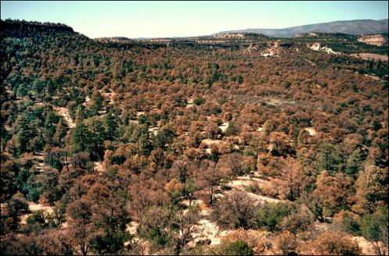
Recent Mortality in the Southwest

Slide 3
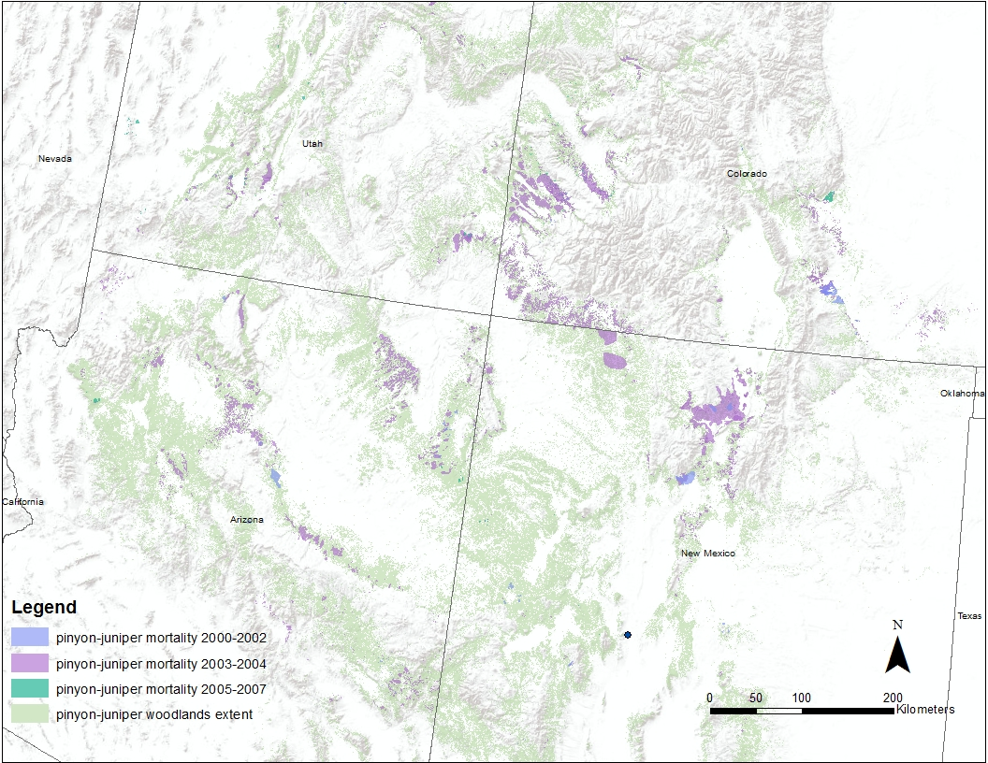
Pinyon pine mortality
peaked in 2003-2004 across the Southwest
From U.S. Forest Service aerial
photographic surveys
.
Peterman et al. 2012. Manuscript revised for Ecohydrology

Slide 4
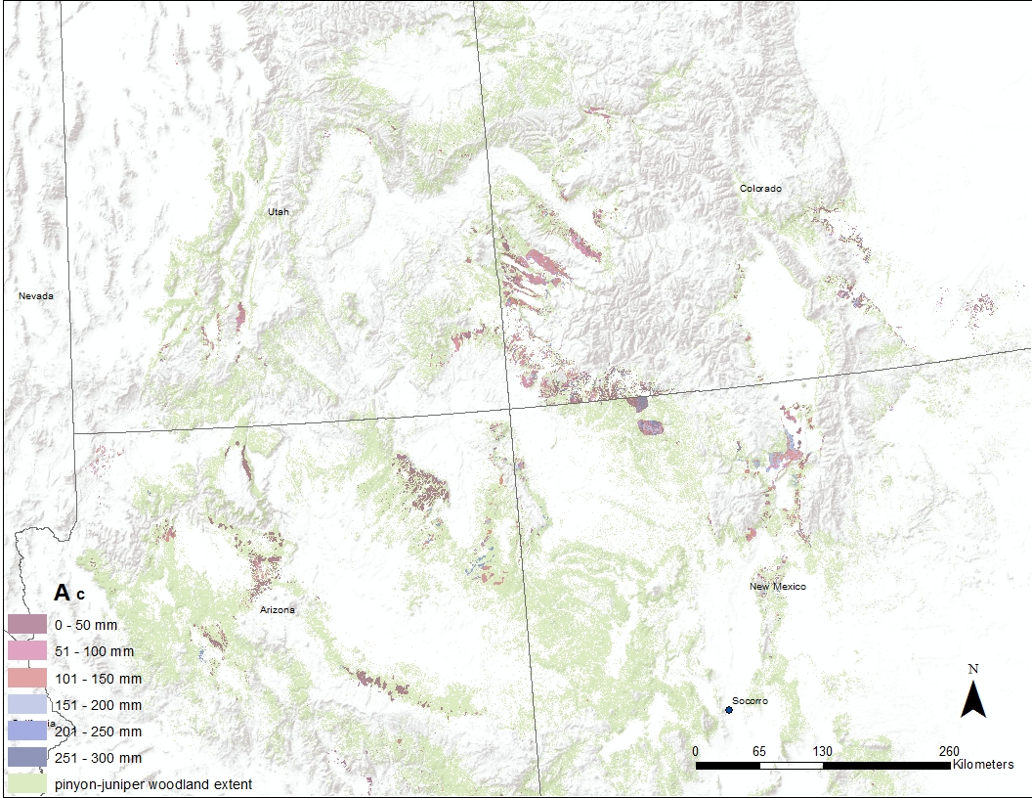
1:24,000 scale soil classification indicates tree mortality in 2003-2004
was concentrated on soils with < 100 mm of water storage capacity
.
NRCS Soil Geographic Database
Peterman et al. 2012. Manuscript revised for Ecohydrology

Slide 5
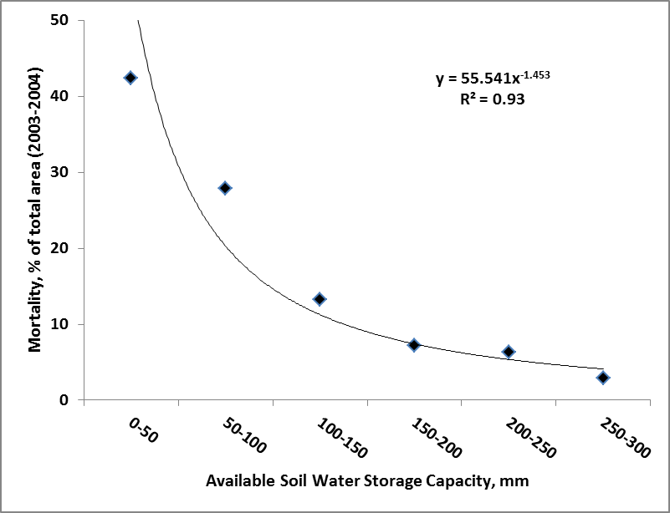
Can predict how tree mortality varies spatially following a drought
with knowledge of differences in soil water storage capacity
.
Peterman et al. 2012. Manuscript revised for Ecohydrology

Slide 6
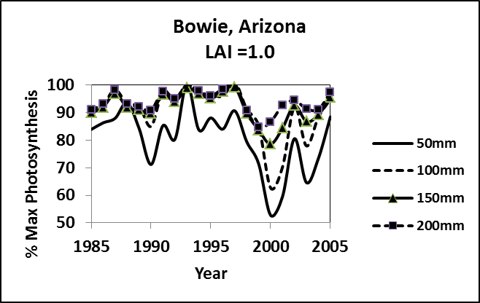
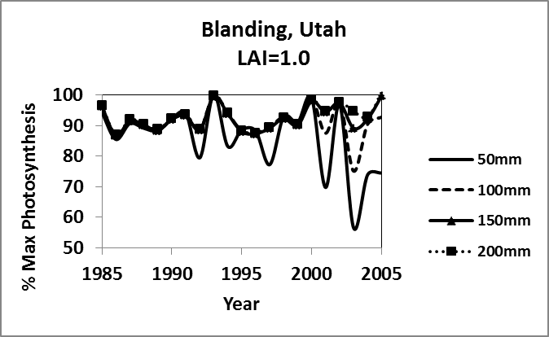
Process-based modeling with 3-PG confirmed that unusually intense
drought would stress pinyon pine on shallow soils prior to 2003-2004
.
Peterman et al. 2012. Manuscript revised for Ecohydrology

Slide 7
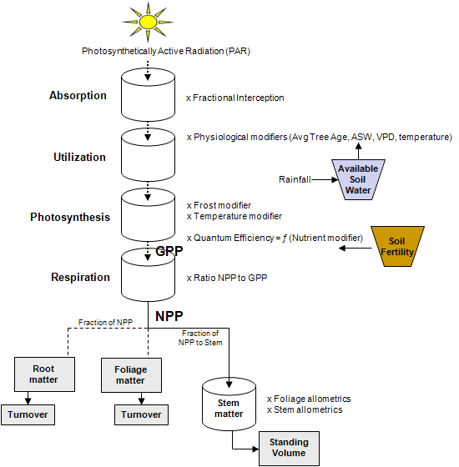
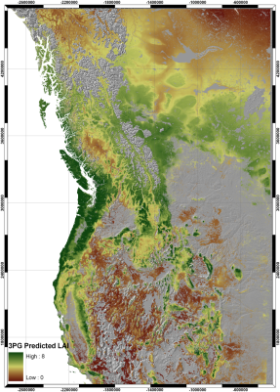
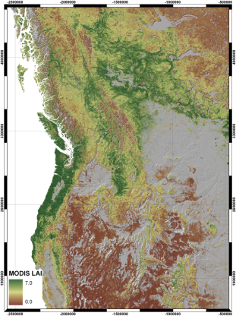
Approach to mapping soil properties
Default at 200 mm ASWC
Default at 50% max. Fert.
3PG Predicted LAI
MODIS LAI
Differences used to adjust soil fertility and soil water holding capacity

Slide 8
Process-model derived
Fertility Ranking at 1 km²
Solved simultaneously,
or set ASWC =170 mm
1:5,000,000 scale
Coops, Hilker & Waring .2011. in preparation RS & E

Slide 9
Process-model derived
Available Soil Water Holding Capacity at 1 km²
Solved simultaneously or
set FR =0.6 if MODIS LAI
is < 3.0 m² m⁻²
1:5,000,000 scale
Coops, Hilker & Waring 2011. in preparation, RS & E

Slide 10
Conclusions
Need soil classification at 1 km² or better :
To predict where tree mortality will occur following drought
To predict variation in productivity under similar climates
To predict the effects of rising CO₂ on growth
Approach to mapping soil properties :
Compare difference in LAI predicted by 3-PG model using default soil values with LAI from MODIS satellite imagery
Run model to match MODIS LAI for soil fertility first
Run model based on est. of soil fertility to obtain map of
available soil water storage capacity
.

Slide 11
Contact Information
Waring, Richard <richard.waring@oregonstate.edu>
http://www.fsl.orst.edu/~waring
Coops, Nicholas
<nicholas.coops@ubc.ca>
Project website:
http://www.pnwspecieschange.info/

